Slide 1

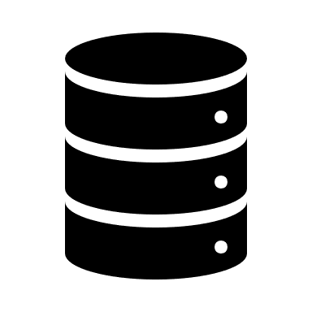
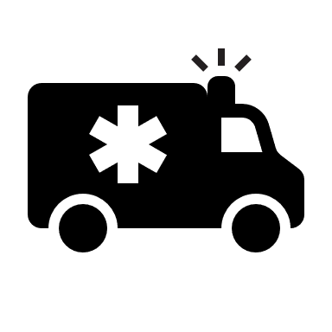
NATIONAL MEDICAL RECORDS DATABASE Management System
A Centralized Patient Management Portal for India

Slide 2
What’s Inside?
Patient Management : The Traditional Methodology
Patient Management : The Current Methodology
What can be new in Patient Management? Idea : National Medical Records Database Management System
Advantages of Centralized Patients Portal
Security Risk & Mitigations
Theoretical Implementation
Conclusion

Slide 3

Traditional Methodology
Patient Management

Slide 4
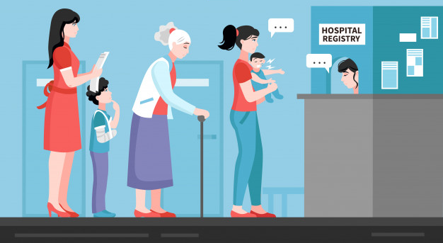
Traditional Methodology
Since the old days, India has got a vast network of hospitals, be it government run or private owned. Patients are naturally consulting a lot of doctors working at various hospitals during their lifetime. Traditionally, people carries all their health records in bulky files and has a lot of papers to manage. Regardless to say, most doctors still can’t validate their authenticity and often prescribe retests of body. This is seen even today where people struggle to wait in long queues just to fill up forms asking same questions in every hospital they visit. This often leads to wastage of time and even hampers timely health care.

Slide 5
Current Methodology
Patient Management

Slide 6

Current Methodology
Presently, there have been many technological advancements in the domain of patient management. Hospitals are moving towards being paperless. But this too is an internal system. Only the doctors & departments within a hospital can share the patient records digitally. Rarely, the branches of same hospital might also be able to share the data over internet. However, no 2 hospitals of different management shares any such patient details even when the patient calls for it. Most often, lab results are withheld by hospitals so that the patients can only consult doctors working there. And as we know, nobody can depend on 1 hospital forever and will eventually have to fill in all previous health and family history at another hospital.

Slide 7

National Medical Records Database Management System
IDEA
What can be new?

Slide 8
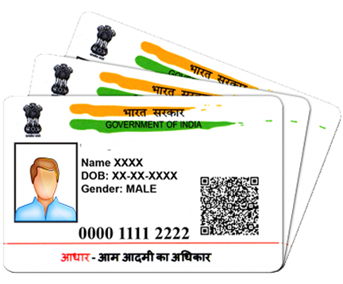
The idea
In today’s India where almost every confidential data of an individual is interlinked with Aadhaar, can we bring it to the domain of patient records management too? We have systems at place to provide vaccination to whoever showing up with an Aadhaar card, to allow voting with a single electoral card & even buy ration from PDS shops anywhere in India with a thumb impression which is linked with Aadhaar. Why don’t we have a centralized system pooled & accessed by all medical institutions with the consent of patient so that his previous family & health records are easily transferable from anywhere in India?

Slide 9
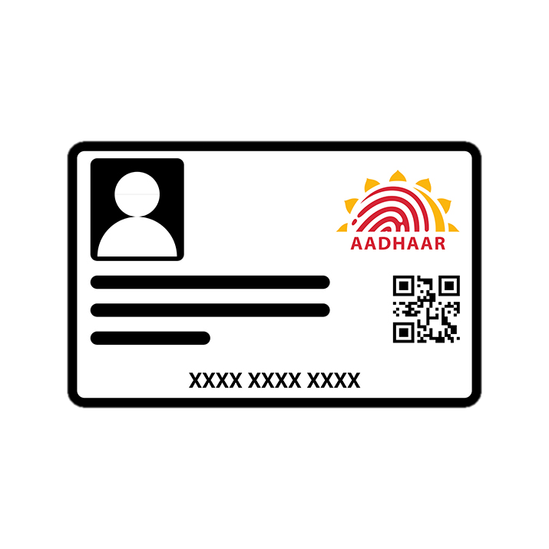
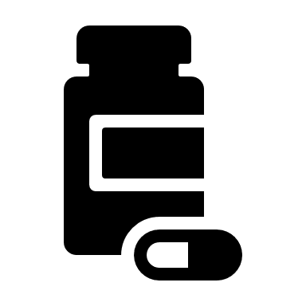
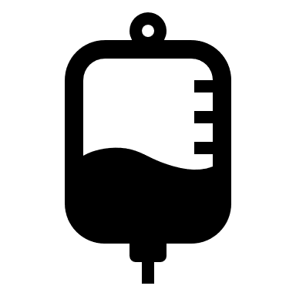
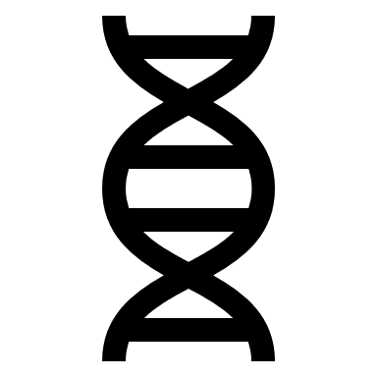
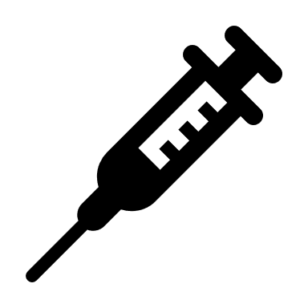
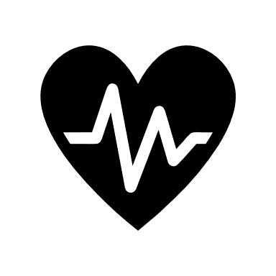
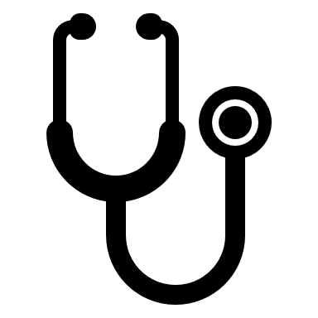
NATIONAL MEDICAL RECORDS DATABASE Management System
National Medical Records Database Management System (NMRDBMS) is our theoretical concept which can deploy such a patient management solution for the entire nation. It’s a web based portal with exclusive access to authorized health institutions pan India. All health records from a person’s birth (or after Aadhaar enrollment) can be retrieved by a thumb impression of the patient. The patient can be given the flexibility to selectively share the required info only (such as the health records from a specific hospital/date). This avoids the need of carrying bulky folders each time you visit a doctor, especially during emergency. There’s no risk of losing the physical records too.

Slide 10

NATIONAL MEDICAL RECORDS DATABASE Management System
There also can be emergency protocols that enables the Police & Hospitals to respond to accident cases with adequate health info about the victim who’s not in a state to answer them. This can be life-saver especially in cases of road accidents where the victim is not accompanied by his/her family and might have other comorbidities. This can also enable law enforcement to quickly inform the concerned family.

Slide 11

Advantages
Easy transferability of health reports between hospitals.
Transparency in treatment.
Time saving when checking in at new hospital.
No need of carrying hard copies of health records.
Vital info about comorbidities of an accident victim and his blood group.
Easier for law enforcement to contact the kin of accident victims.
Easier recovery of lost health records & papers.

Slide 12

Security Risks and mitigation
Anything online has cyber security risks. However, we already have almost every sensitive data online with the introduction of Aadhaar. Hence, we must trust the security of Aadhaar here as this too is based on Aadhaar. Another risk could be the potential misuse by health institutions which can be mitigated by security features such as requirement of biometric key (fingerprint) to access health records of a person. Again, there should be strict laws in force against data abuse by hospitals. Also, there should be control on what info can be accessed by hospitals with the consent.

Slide 13
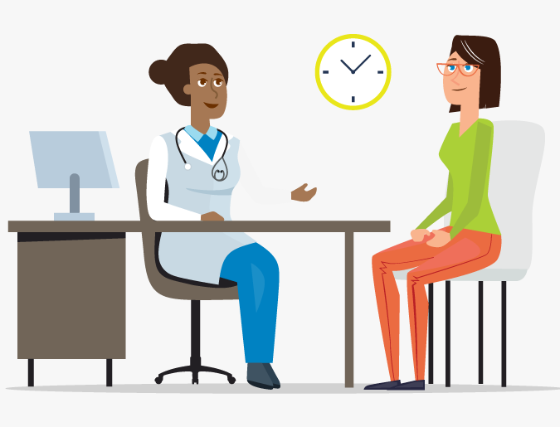
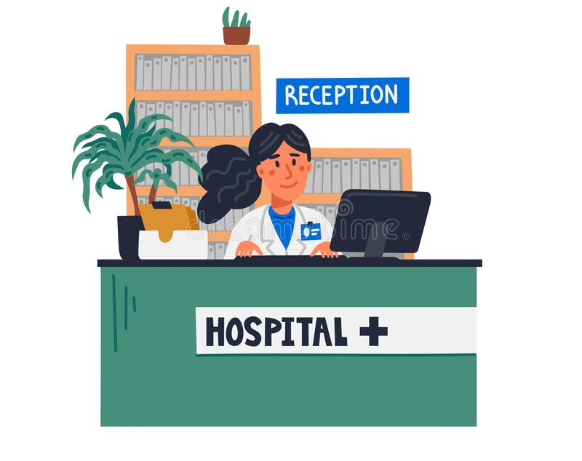
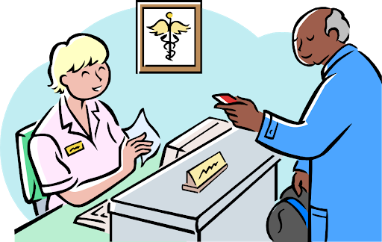
Theoretical Implementation
At Hospital Reception
Provide Aadhaar Number & Fingerprint.
Specify the health records to be transferred (date or the name of previous hospital/doctor).
Patient can receive SMS confirmation of the data accessed.
A look at his/her screen enables the Doctor to know the patient’s health history even if it’s the first consultation. This results in faster diagnosis, avoids retests of body & saves time of other patients waiting.

Slide 14
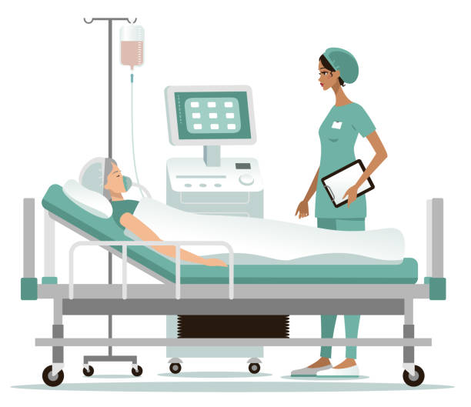
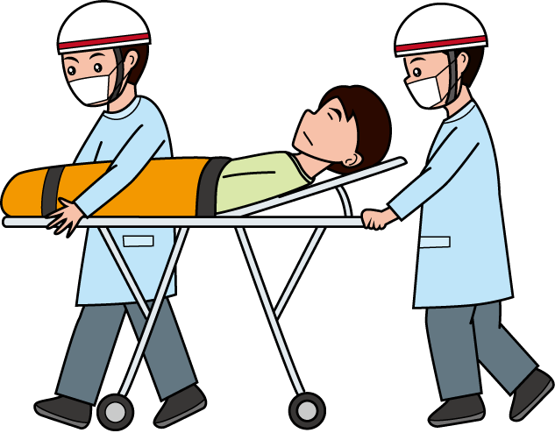
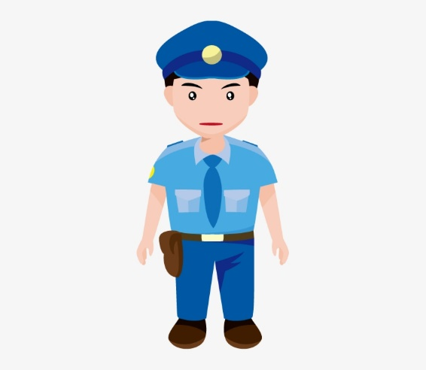

Theoretical Implementation
Police can know the basic contact info of the patient for further proceedings.
Doctors attending the case can have clear info about any serious comorbidities of the patient that needs attention and his blood group.
Patient’s trusted contact can receive SMS confirmation of the data accessed.
In case of admitting an accident victim or other emergencies where the patient is unknown.
Golden Hour Care can be most effective with retrieved health data.

Slide 15

Conclusion
Having a centralized web interface for Patient Management is a futuristic solution to many healthcare problems in India especially at this pandemic time where people end up in hospitals they haven’t been to & standing for long in queues aren’t cool with risk of infections. Such system can also make future vaccination drives a lot simplified. Though we can provide a working model & prototype, the implementation depends on the political will as Indian Government control is mandatory for Aadhaar enabled solutions. Gladly, we’ve seen effective use of Aadhaar authentication in COVID-19 vaccination centers & this can be further modified into our proposed system. Let’s hope that Indian Medical Sector will be more advanced and futuristic soon with such a National Medical Records Database Management System as the backbone.

Slide 16
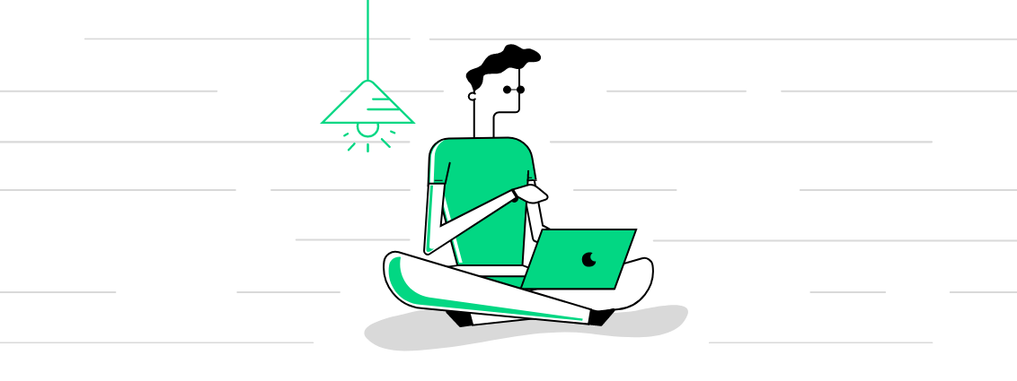
Thank You!
Team: Open Source Bandits

